Slide 1
PII – Identifying and Managing Risk
Presented by:
UNL Office of Internal Audit and ITS Security
March 2014

Slide 2
Annual PII update with Chancellor Perlman and SAT
For the past 3 years the Office of Internal Audit and Information Technology Services have updated the Chancellor and SAT on the status of PII stored/used at UNL
Share inventory of the total number of PII records
Focus placed on data stores with 10,000 or more unique records
Include trends from the past year
Is total number going up or down?
Document details about how data is being secured

Slide 3
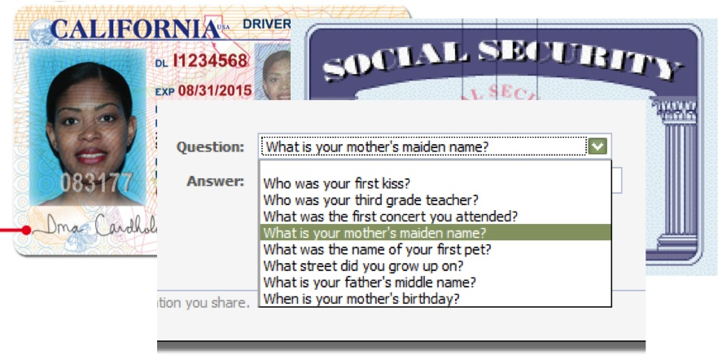
What is PII?
PII is described by state statute
SSN's
drivers license numbers
biometric information
credit card numbers
and financial account information when combined with a PIN and the records include a first and last name, or first initial and last name.

Slide 4
Identity Exposure Risk Areas
Administrative Areas
Faculty Areas
Research Areas
Employees with Longevity

Slide 5
Administrative Areas
HR Responsibilities
PAF, Salary
Supervisors
Employee Evaluations

Slide 6
Faculty Areas
Grade Books
Student Papers
Publications
Conference Material

Slide 7
Research
Servers administrated by Researchers
Accounts and authentication protocols
Remote Access and VPN
Graduate Student shared computers
Personal information requirements

Slide 8
Employees with Longevity
Prior to 2005
Forgotten data
Moved data during hardware upgrades without cleansing
Previous Responsibilities

Slide 9
IT Role
Educate Data Owner
Data Security Classification
Public Data
Non-Public Data
Confidential Data (Identity Finder
http://its.unl.edu/ea/unl-data-security-guidelines-definitions
Consult with Data Security (Rick)
All PII must be Registered
VPN Adherence

Slide 10
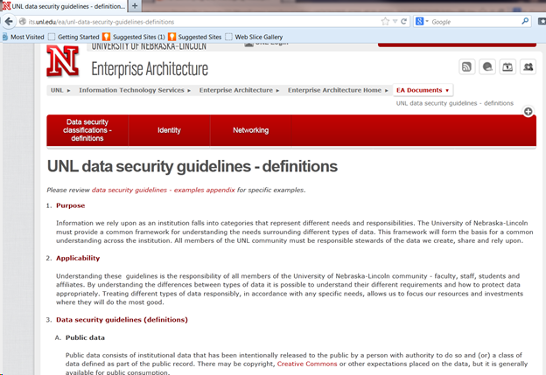

Slide 11
Identifying the Risk
Identity Finder
A tool to scan desktops, laptops and servers searching for records with PII in them
The tool is available from Dan Buser in ITS Security
Department tech staff can have access to the admin console to manage scan results from their computers.

Slide 12
Identifying the Risk
Symantec Data Loss Prevention (Vontu)
Scanning appliances at the edge of UNL network looking for PII entering or leaving the campus
Data is flagged if is believed to contain PII, sender is contacted if it is indeed PII.

Slide 13
Mitigating the Risks
Deploy Identity Finder on all desktops, laptops and servers
It is hard to protect/manage what we don’t know we have
Ability to deploy Identity Finder with our new client management tools (Casper and SCCM)
Performing regular scans on all desktops, laptops and servers will lower our risk of exposure
Keep all operating systems patched, and applications up-to-date
Disable all ports and services that are not needed
Enable logging
Regularly check logs

Slide 14
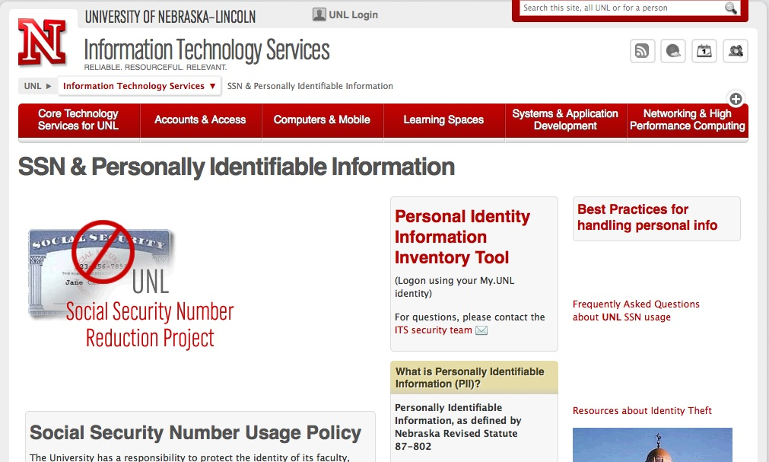

Role We Can Play
Educate data owner on Data Classification (maybe include 3 levels)
Keep ITS Security in the loop
All PII being used or stored needs to be registered at http://its.unl.edu/ssn

Slide 15

Questions?
©2007 The Board of Regents of the University of Nebraska. All rights reserved.
Notes:
This would be the last slide, click the text to change it to your information.

